Slide 1
Sentiment Analysis On Tweets
Presented By :-
Sudhanshu Mishra
160101603

Slide 2
Table of Content
Functions
Description
Api
Application

Slide 3
Function
Collect recent tweets in a real time fashion i.e. from the twitter stream based on specified topic by the user.
Remove special characters or filter the tweet to remove unnecessary characters.
Check the language of the tweet and if it is not in English then the tweet should be translated into English such that analysis can be performed.
Perform sentiment analysis on these tweets to classify them as positive , negative or neutral.
Show the result to the user by performing the necessary computation.

Slide 4
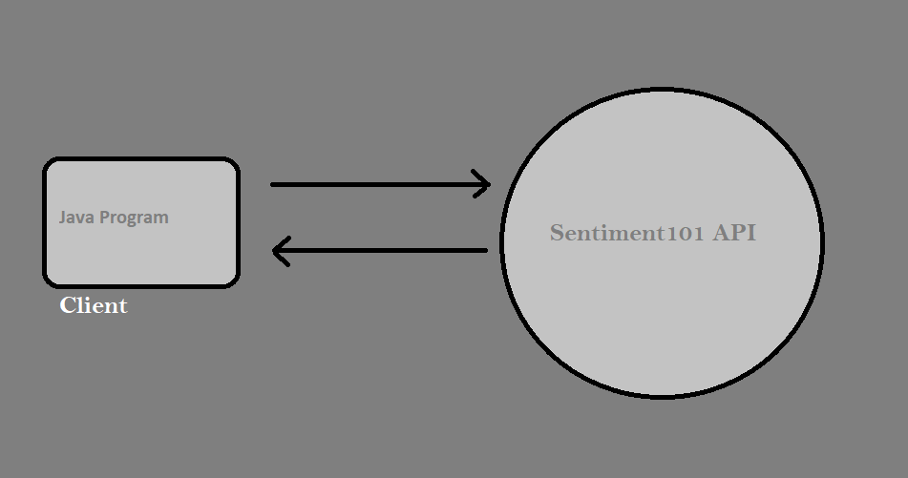
Description

Slide 5
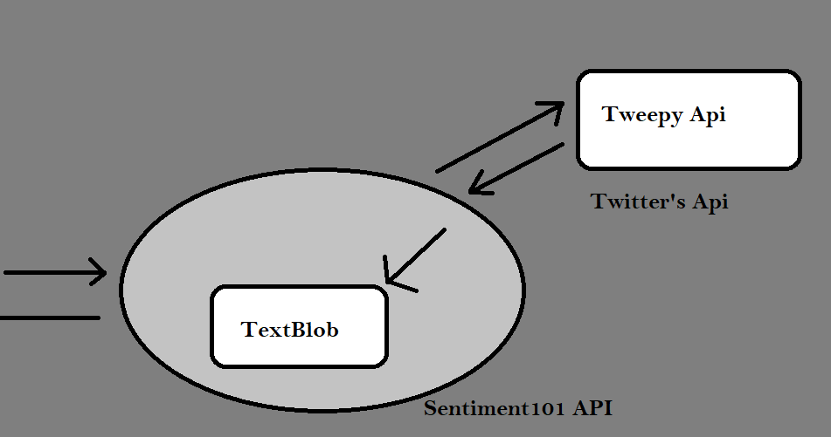

Slide 6
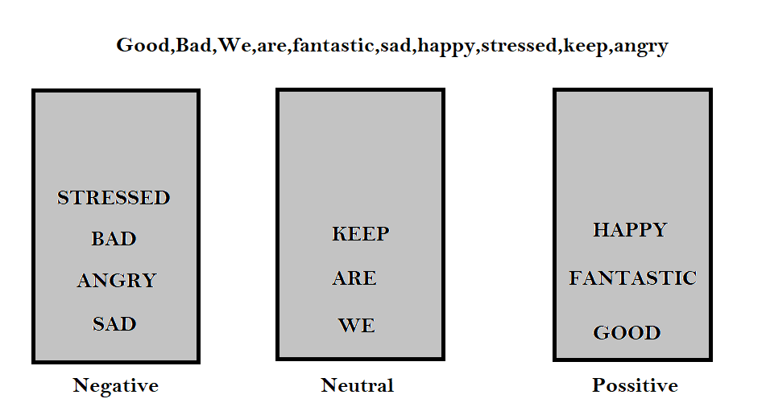

Slide 7
API
The API is written in python using flask microframework, it is responsible for receiving the topic during the request from the user.
The second job of the ape is requesting for 100 recent tweets from the tweepy API provided by twitter.
The authentication for the retrieval of these tweets will be completed by using the authentication tokens given during the registration for the API.
After receiving the response from tweepy API each tweet is analyzed using TextBlob python library for sentiment analysis.
On the completion of the whole procedure each of the hundred tweets is categorized as Positive, Negative and Neutral.
Then the next responsibility is to respond the application with appropriate result that will be number of positive, negative, neutral tweets and the total number of tweets analyzed (100-fixed).
The format in which data will be transferred will be Javascript Object Notation (JSON).
APPICATION PROGRAM INTERFACE

Slide 8
This the client application only responsible for calling the API with the topic entered by the user.
The user provides input with the topic on which he wants to know the opinion of the twitter community.
After taking the input from the user it calls the API with requesting the result on that particular topic.
After the API processes the result it responses with the respective result to the application which further the application uses to plot a pie chart and provides the user with appropriate results.
APPICATION
JAVA

Slide 9


